Slide 1
INTRODUCTION TO COMPUTING
Course Code: CCINCOM/L
Planning by Dynamic Programming
Elizer Ponio Jr.
Faculty Member
Department of Computer Science
College of Computing and Information Technologies (CCIT)
National University
Joseph Marvin R. Imperial
REINFORCEMENT LEARNING
NU College of Computing and Information Technologies
Course Code: CCRNFLRL

Slide 2
Outline
INTRODUCTION TO COMPUTING
Course Code: CCINCOM/L
Dynamic Programming
Policy Evaluation
Policy Iteration
Value Iteration
Joseph Marvin R. Imperial
REINFORCEMENT LEARNING
NU College of Computing and Information Technologies
Course Code: CCRNFLRL

Slide 3
Dynamic Programming
INTRODUCTION TO COMPUTING
Course Code: CCINCOM/L
Dynamic programming is a technique to solve a certain set of problems.
Dynamic programming cannot be used to solve all problems.
Dynamic programming can only be used to solve the kind of problems that have certain properties and can be solved in a certain way.
Used in different domains such as math, bioinformatics, game theory, economics, statistics, linguistics and computer science.
Joseph Marvin R. Imperial
REINFORCEMENT LEARNING
NU College of Computing and Information Technologies
Course Code: CCRNFLRL

Slide 4
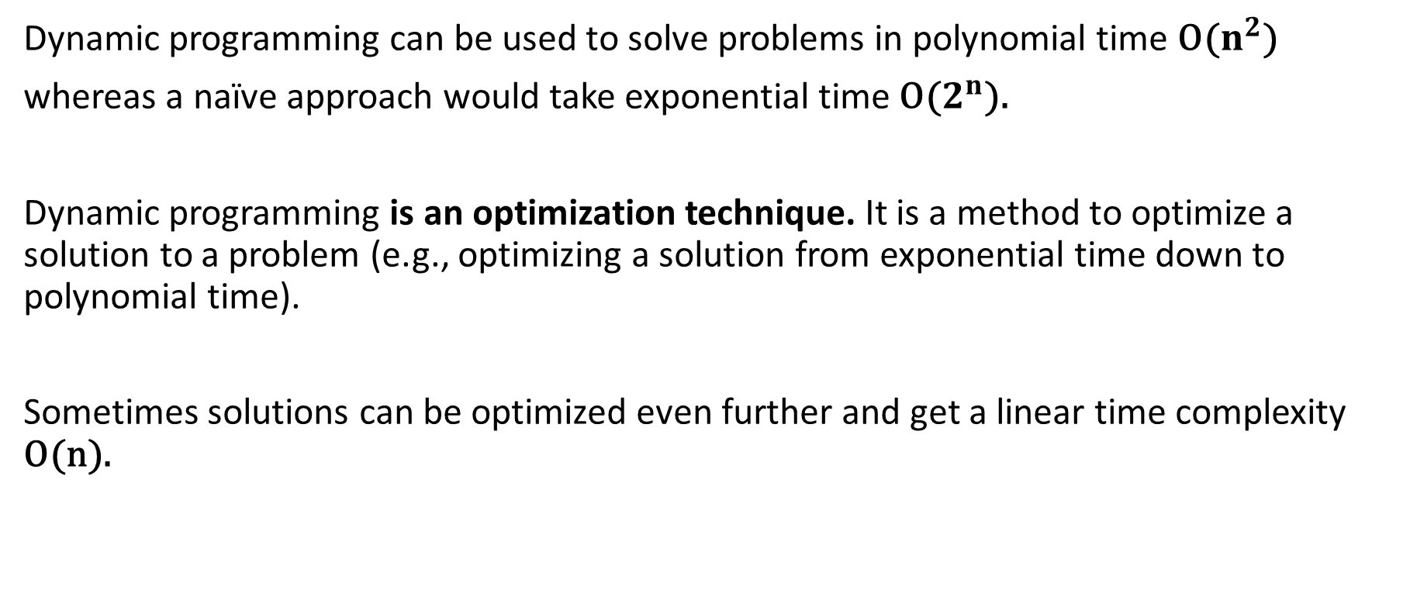
Why does Dynamic Programming exist?
INTRODUCTION TO COMPUTING
Course Code: CCINCOM/L
Dynamic programming can be used to solve problems in polynomial time O($n^{2}$)
whereas a naïve approach would take exponential time O($2^{n}$).
Dynamic programming is an optimization technique. It is a method to optimize a solution to a problem (e.g., optimizing a solution from exponential time down to polynomial time).
Sometimes solutions can be optimized even further and get a linear time complexity O(n).
Joseph Marvin R. Imperial
REINFORCEMENT LEARNING
NU College of Computing and Information Technologies
Course Code: CCRNFLRL

Slide 5
When to use Dynamic Programming?
INTRODUCTION TO COMPUTING
Course Code: CCINCOM/L
What are the characteristics of a problem that tells us that we can apply dynamic programming to solve it?
A problem must have two properties:
Optimal Substructure
Optimal simply means “the best ” or “most desirable”.
Substructure means the subproblem of a main problem.
A problem has an optimal substructure property when its optimal solution can be constructed from the optimal solutions of its subproblems.
By solving each subproblem in its most optimal way we obtain optimal solution to the main problem.
Joseph Marvin R. Imperial
REINFORCEMENT LEARNING
NU College of Computing and Information Technologies
Course Code: CCRNFLRL

Slide 6
Optimal Substructure
INTRODUCTION TO COMPUTING
Course Code: CCINCOM/L
Main Problem
Instead of solving the entire problem at once
Joseph Marvin R. Imperial
REINFORCEMENT LEARNING
NU College of Computing and Information Technologies
Course Code: CCRNFLRL

Slide 7
Optimal Substructure
INTRODUCTION TO COMPUTING
Course Code: CCINCOM/L
Subproblem 2
Subproblem 1
Subproblem 4
Subproblem 3
To get the optimal solution of the main problem, break it down into smaller subproblems and solve one problem at a time in an optimal way.
Joseph Marvin R. Imperial
REINFORCEMENT LEARNING
NU College of Computing and Information Technologies
Course Code: CCRNFLRL

Slide 8
Optimal Substructure
INTRODUCTION TO COMPUTING
Course Code: CCINCOM/L
Subproblem 2
Subproblem 1
Subproblem 4
Subproblem 3
Once an optimal solution is found for Subproblem 1, we can extend the problem space and solve Subproblem 2
Solving Subproblem 2 does not require resolving Subproblem 1. We can use the result of Subproblem 1 to solve Subproblem 2
This process is repeated until all subproblems are solved.
Joseph Marvin R. Imperial
REINFORCEMENT LEARNING
NU College of Computing and Information Technologies
Course Code: CCRNFLRL

Slide 9
Optimal Substructure
INTRODUCTION TO COMPUTING
Course Code: CCINCOM/L
Subproblem 2
Subproblem 1
Subproblem 4
Subproblem 3
This is the core idea of dynamic programming!
Joseph Marvin R. Imperial
REINFORCEMENT LEARNING
NU College of Computing and Information Technologies
Course Code: CCRNFLRL

Slide 10
When to use Dynamic Programming?
INTRODUCTION TO COMPUTING
Course Code: CCINCOM/L
Overlapping Subproblems
Subproblems recur many times
Solutions can be cached or reused
Fib(5)
Fib(4)
Fib(3)
Fib(3) was recalculated twice!
Fib(3)
Fib(2)
Joseph Marvin R. Imperial
REINFORCEMENT LEARNING
NU College of Computing and Information Technologies
Course Code: CCRNFLRL

Slide 11
How do we find problems that are perfect for DP?
INTRODUCTION TO COMPUTING
Course Code: CCINCOM/L
Combinatoric problems
How many ways to make a change?
How many ways to traverse a graph?
How many steps needed to get from point A to point B?
Your objective is to count something.
Optimization problems
What is the minimum number of steps needed to get from point A to point B?
What is the maximum profit gained by buying and selling stock?
What is the minimum cost to travel from Manila to Baguio?
Your objective is to minimize or maximize some function.
Joseph Marvin R. Imperial
REINFORCEMENT LEARNING
NU College of Computing and Information Technologies
Course Code: CCRNFLRL

Slide 12
Dynamic Programming for MDP
INTRODUCTION TO COMPUTING
Course Code: CCINCOM/L
Markov decision processes satisfy both properties
Bellman equation gives recursive decomposition
Value function stores and reuses solutions
Joseph Marvin R. Imperial
REINFORCEMENT LEARNING
NU College of Computing and Information Technologies
Course Code: CCRNFLRL

Slide 13
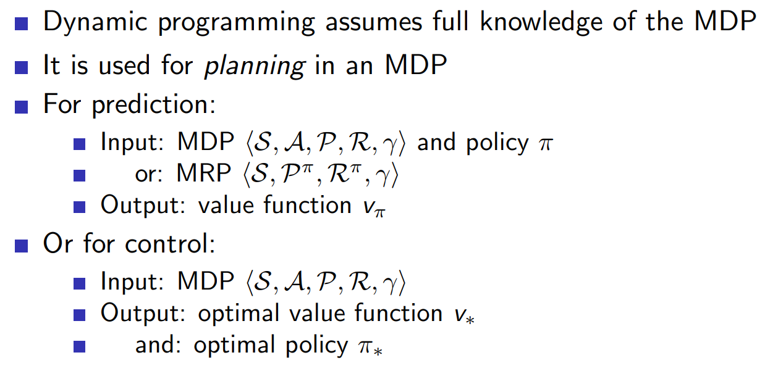
Planning by DP
INTRODUCTION TO COMPUTING
Course Code: CCINCOM/L
Joseph Marvin R. Imperial
REINFORCEMENT LEARNING
NU College of Computing and Information Technologies
Course Code: CCRNFLRL

Slide 14
Outline
INTRODUCTION TO COMPUTING
Course Code: CCINCOM/L
Dynamic Programming
Policy Evaluation
Policy Iteration
Value Iteration
Joseph Marvin R. Imperial
REINFORCEMENT LEARNING
NU College of Computing and Information Technologies
Course Code: CCRNFLRL

Slide 15

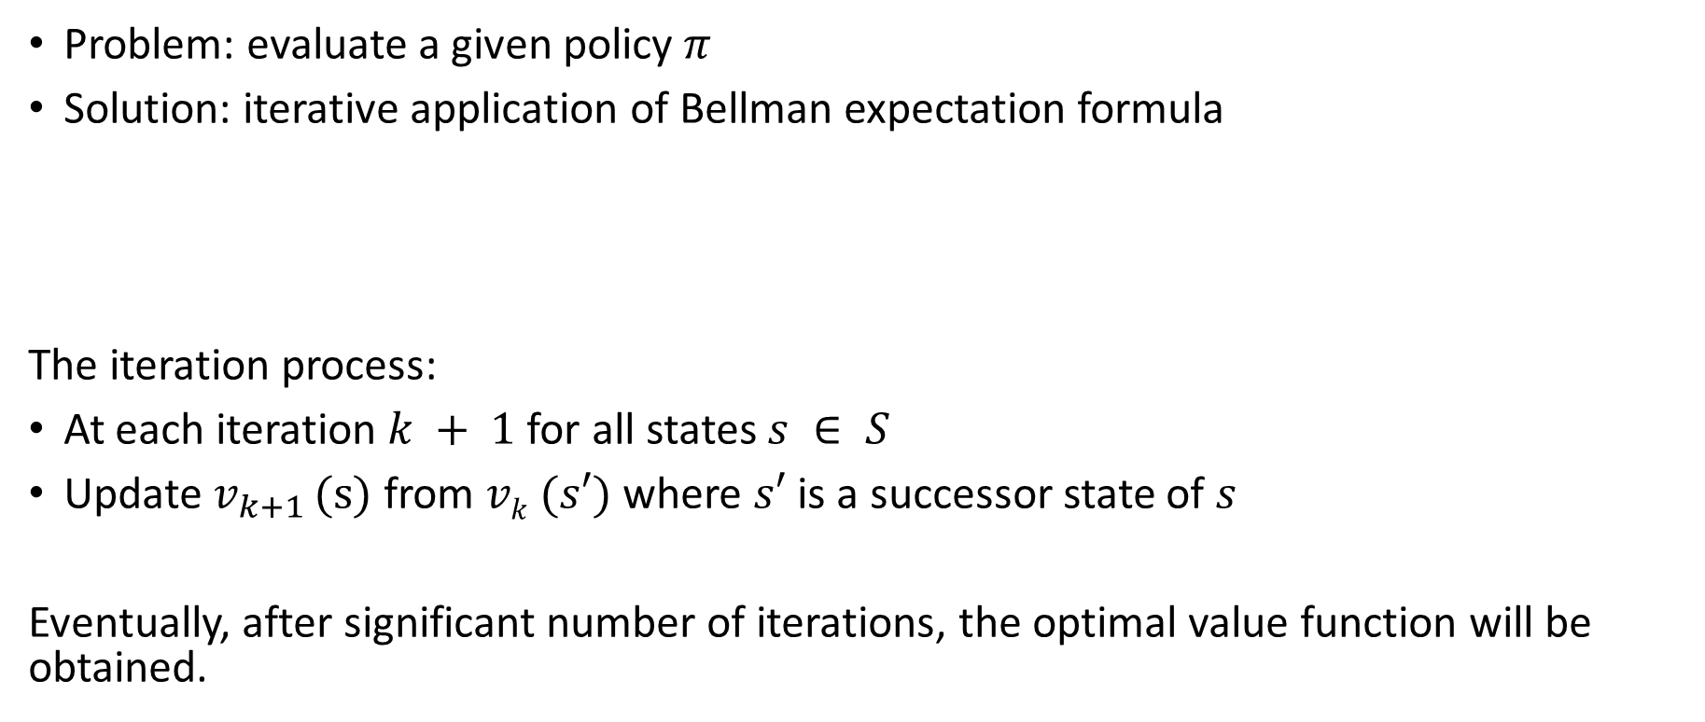
Iterative Policy Evaluation (Prediction Problem)
INTRODUCTION TO COMPUTING
Course Code: CCINCOM/L
Problem: evaluate a given policy$π$
Solution: iterative application of Bellman expectation formula
The iteration process:
At each iteration $k + 1$for all states $s ∈ S$
Update $v_{k+1 }$(s) from $vk (s′)$where $s′$ is a successor state of $s$
Eventually, after significant number of iterations, the optimal value function will be obtained.
Joseph Marvin R. Imperial
REINFORCEMENT LEARNING
NU College of Computing and Information Technologies
Course Code: CCRNFLRL

Slide 16
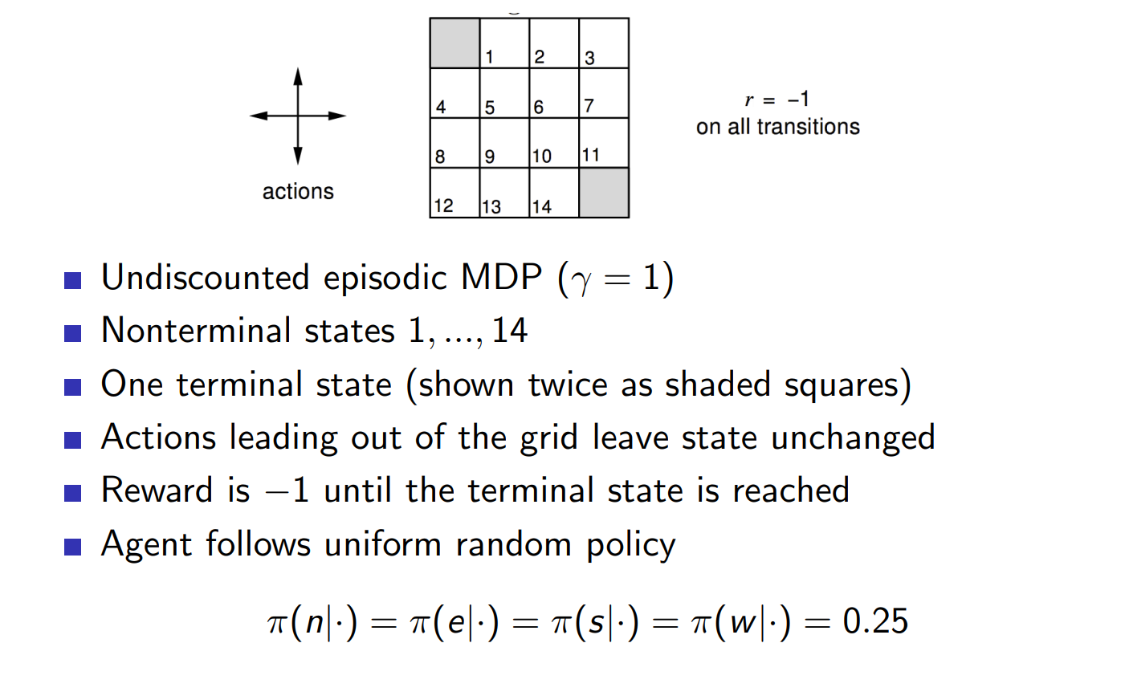
Iterative Policy Evaluation in Small Gridworld
INTRODUCTION TO COMPUTING
Course Code: CCINCOM/L
Joseph Marvin R. Imperial
REINFORCEMENT LEARNING
NU College of Computing and Information Technologies
Course Code: CCRNFLRL

Slide 17
Course Code: CCINCOM/L
 | 1 | 2 | 3
4 | 5 | 6 | 7
8 | 9 | 10 | 11
12 | 13 | 14
TERMINAL STATE
Successor state
(s’)
r = -1
on all transitions
Successor state
(s’)
State
(s)
Successor state
(s’)
actions = {up, down, left, right}
Agent follows a random policy (25% probability for all actions)
Successor state
(s’)
TERMINAL STATE
NU College of Computing and Information Technologies
Course Code: CCRNFLRL
Joseph Marvin R. Imperial
REINFORCEMENT LEARNING

Slide 18
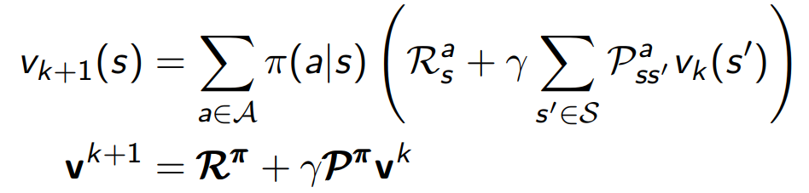






Course Code: CCINCOM/L
 | 1 | 2 | 3
4 | 5 | 6 | 7
8 | 9 | 10 | 11
12 | 13 | 14
TERMINAL STATE
$v_{0}$(s’)
$v_{0}$(s’)
$v_{1}$(s) =?
$v_{0}$(s’)
Apply the Bellman Expectation formula at each step
$v_{0}$(s’)
TERMINAL STATE
$$At k=0$$
Course Code: CCRNFLRL
Joseph Marvin R. Imperial
REINFORCEMENT LEARNING

Slide 19






Course Code: CCINCOM/L
 | 1 | 2 | 3
4 | 5 | 6 | 7
8 | 9 | 10 | 11
12 | 13 | 14
TERMINAL STATE
$v_{1}$(s’)
$v_{1}$(s’)
$v_{2}$(s) =?
$v_{1}$(s’)
Apply the Bellman Expectation formula at each step
$v_{1}$(s’)
TERMINAL STATE
$$At k=1$$
Course Code: CCRNFLRL
Joseph Marvin R. Imperial
REINFORCEMENT LEARNING

Slide 20
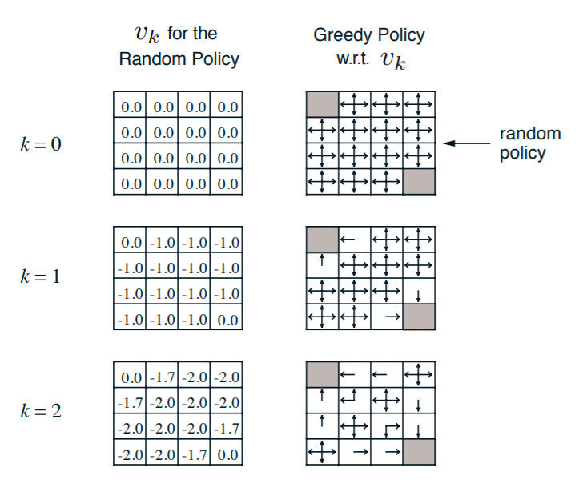
Iterative Policy Evaluation in Small Gridworld
INTRODUCTION TO COMPUTING
Course Code: CCINCOM/L
Joseph Marvin R. Imperial
REINFORCEMENT LEARNING
NU College of Computing and Information Technologies
Course Code: CCRNFLRL

Slide 21
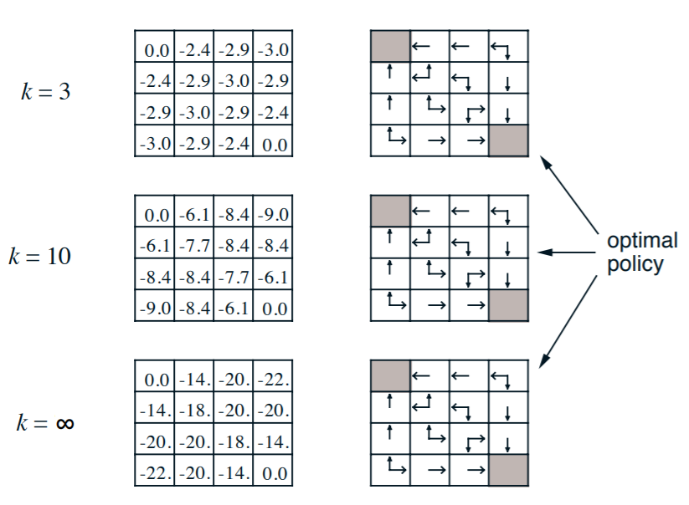
Iterative Policy Evaluation in Small Gridworld
INTRODUCTION TO COMPUTING
Course Code: CCINCOM/L
Joseph Marvin R. Imperial
REINFORCEMENT LEARNING
NU College of Computing and Information Technologies
Course Code: CCRNFLRL

Slide 22
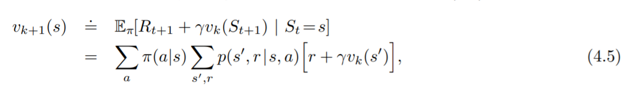

DP Implementation
INTRODUCTION TO COMPUTING
Course Code: CCINCOM/L
To write a sequential computer program to implement iterative policy evaluation as given by (4.5) you would have to use two arrays, one for the old values, v_{k}(s), and one for the new values, v_{k+1}(s).
With two arrays, the new values can be computed one by one from the old values without the old values being changed.
Bellman equation as an update rule for finding best$v(s)$function
Joseph Marvin R. Imperial
REINFORCEMENT LEARNING
NU College of Computing and Information Technologies
Course Code: CCRNFLRL

Slide 23
Outline
INTRODUCTION TO COMPUTING
Course Code: CCINCOM/L
Dynamic Programming
Policy Evaluation
Policy Iteration
Value Iteration
Joseph Marvin R. Imperial
REINFORCEMENT LEARNING
NU College of Computing and Information Technologies
Course Code: CCRNFLRL

Slide 24
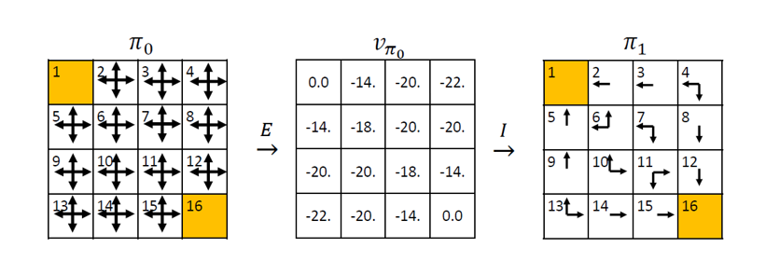
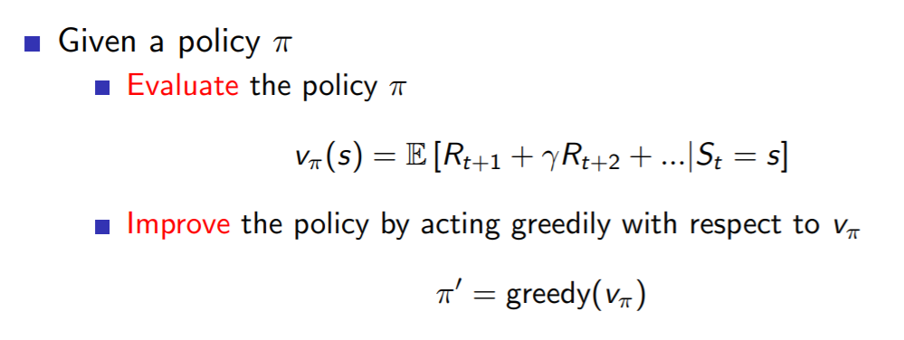
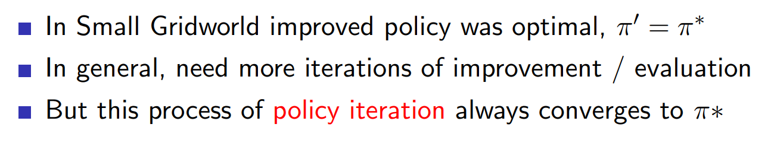
Policy Improvement
INTRODUCTION TO COMPUTING
Course Code: CCINCOM/L
Our reason for computing the value function for a policy is to help find better policies.
Joseph Marvin R. Imperial
REINFORCEMENT LEARNING
NU College of Computing and Information Technologies
Course Code: CCRNFLRL

Slide 25
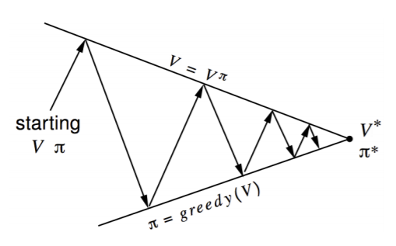
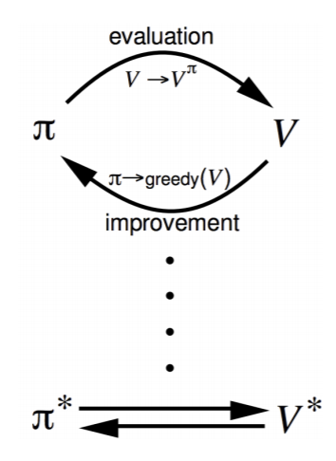
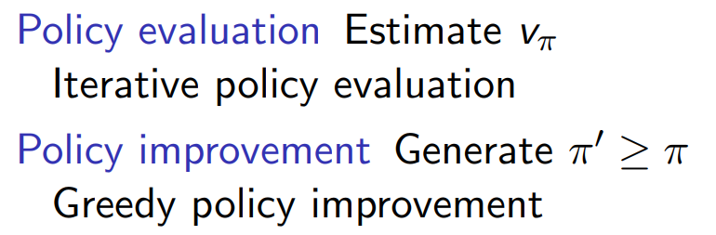
Policy Iteration
INTRODUCTION TO COMPUTING
Course Code: CCINCOM/L
Joseph Marvin R. Imperial
REINFORCEMENT LEARNING
NU College of Computing and Information Technologies
Course Code: CCRNFLRL
Notes:
Act greedily with respect to our value function to generate a new policy

Slide 26
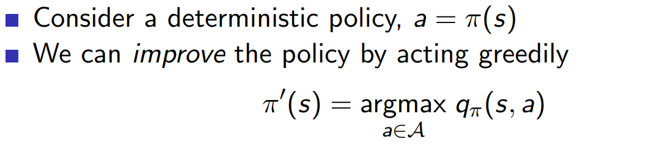
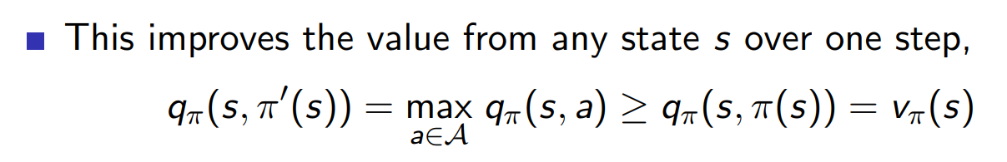
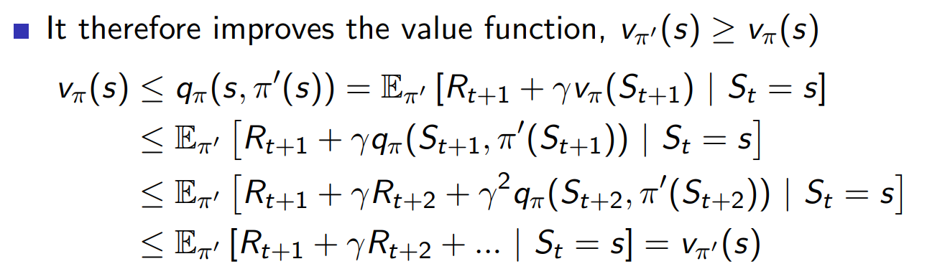
Policy Improvement
INTRODUCTION TO COMPUTING
Course Code: CCINCOM/L
Joseph Marvin R. Imperial
REINFORCEMENT LEARNING
NU College of Computing and Information Technologies
Course Code: CCRNFLRL
Notes:
Acting greedily means pick actions in a way that gives us a maximum action value (q).
Action value (q) is the immediate reward plus the value function where you end up.
Follow new greedy policy from one step then follow policy from then onwards starting in s.
Following a greedy policy for one step is better than following the old policy
Then iterate the same process for two, three, four, five steps.

Slide 27
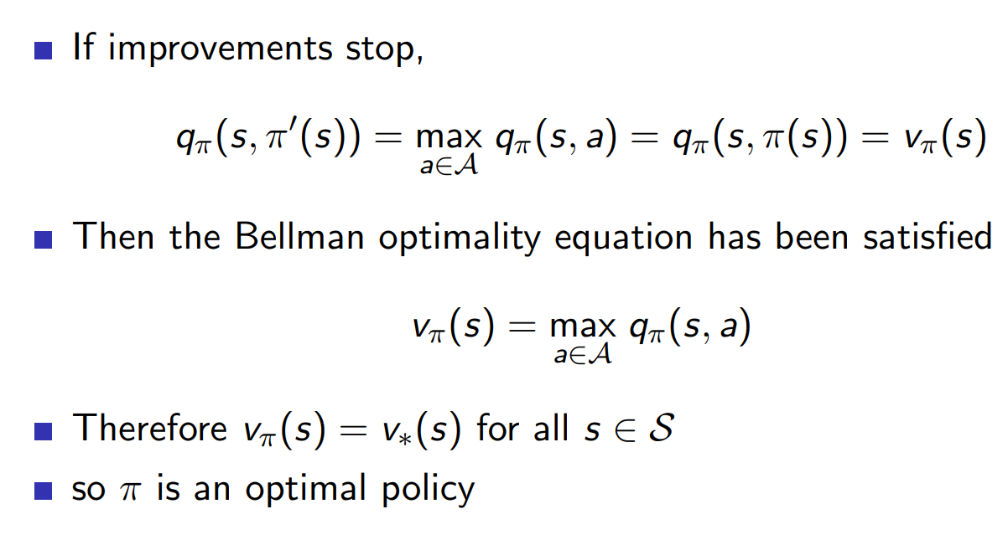
Policy Improvement
INTRODUCTION TO COMPUTING
Course Code: CCINCOM/L
Joseph Marvin R. Imperial
REINFORCEMENT LEARNING
NU College of Computing and Information Technologies
Course Code: CCRNFLRL
Notes:
Acting greedily means pick actions in a way that gives us a maximum action value (q).
Action value (q) is the immediate reward plus the value function where you end up.
Follow new greedy policy from one step then follow policy from then onwards starting in s.
Following a greedy policy for one step is better than following the old policy
Then iterate the same process for two, three, four, five steps.

Slide 28
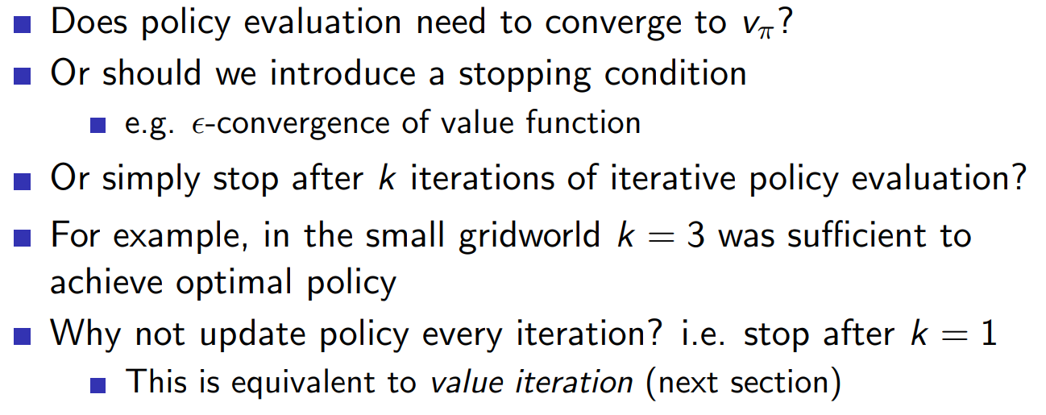
Modified Policy Iteration
INTRODUCTION TO COMPUTING
Course Code: CCINCOM/L
Joseph Marvin R. Imperial
REINFORCEMENT LEARNING
NU College of Computing and Information Technologies
Course Code: CCRNFLRL
Notes:
Acting greedily means pick actions in a way that gives us a maximum action value (q).
Action value (q) is the immediate reward plus the value function where you end up.
Follow new greedy policy from one step then follow policy from then onwards starting in s.
Following a greedy policy for one step is better than following the old policy
Then iterate the same process for two, three, four, five steps.

Slide 29
Outline
INTRODUCTION TO COMPUTING
Course Code: CCINCOM/L
Dynamic Programming
Policy Evaluation
Policy Iteration
Value Iteration
Joseph Marvin R. Imperial
REINFORCEMENT LEARNING
NU College of Computing and Information Technologies
Course Code: CCRNFLRL

Slide 30
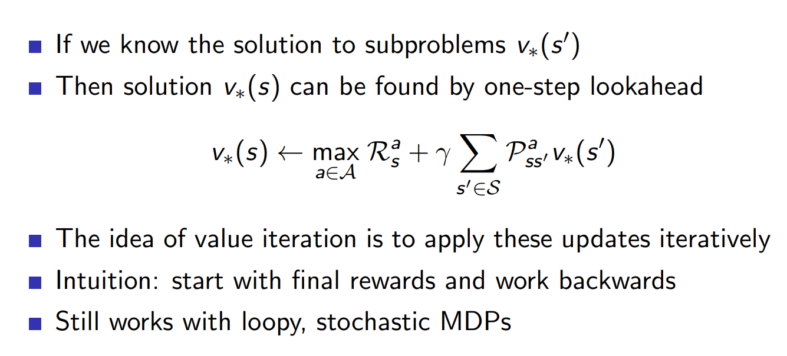
Value Iteration
INTRODUCTION TO COMPUTING
Course Code: CCINCOM/L
Joseph Marvin R. Imperial
REINFORCEMENT LEARNING
NU College of Computing and Information Technologies
Course Code: CCRNFLRL
Notes:
Acting greedily means pick actions in a way that gives us a maximum action value (q).
Action value (q) is the immediate reward plus the value function where you end up.
Follow new greedy policy from one step then follow policy from then onwards starting in s.
Following a greedy policy for one step is better than following the old policy
Then iterate the same process for two, three, four, five steps.

Slide 31
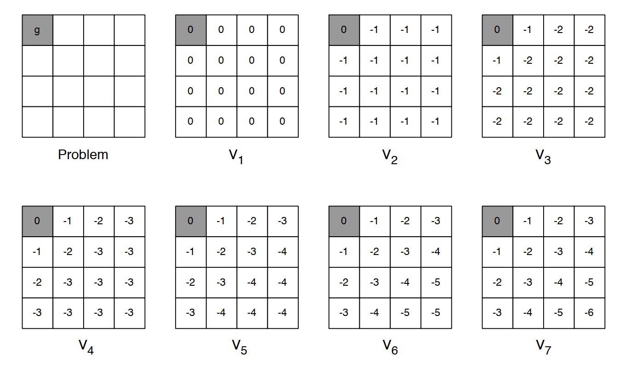
Value Iteration
INTRODUCTION TO COMPUTING
Course Code: CCINCOM/L
Joseph Marvin R. Imperial
REINFORCEMENT LEARNING
NU College of Computing and Information Technologies
Course Code: CCRNFLRL
Notes:
Acting greedily means pick actions in a way that gives us a maximum action value (q).
Action value (q) is the immediate reward plus the value function where you end up.
Follow new greedy policy from one step then follow policy from then onwards starting in s.
Following a greedy policy for one step is better than following the old policy
Then iterate the same process for two, three, four, five steps.

Slide 32
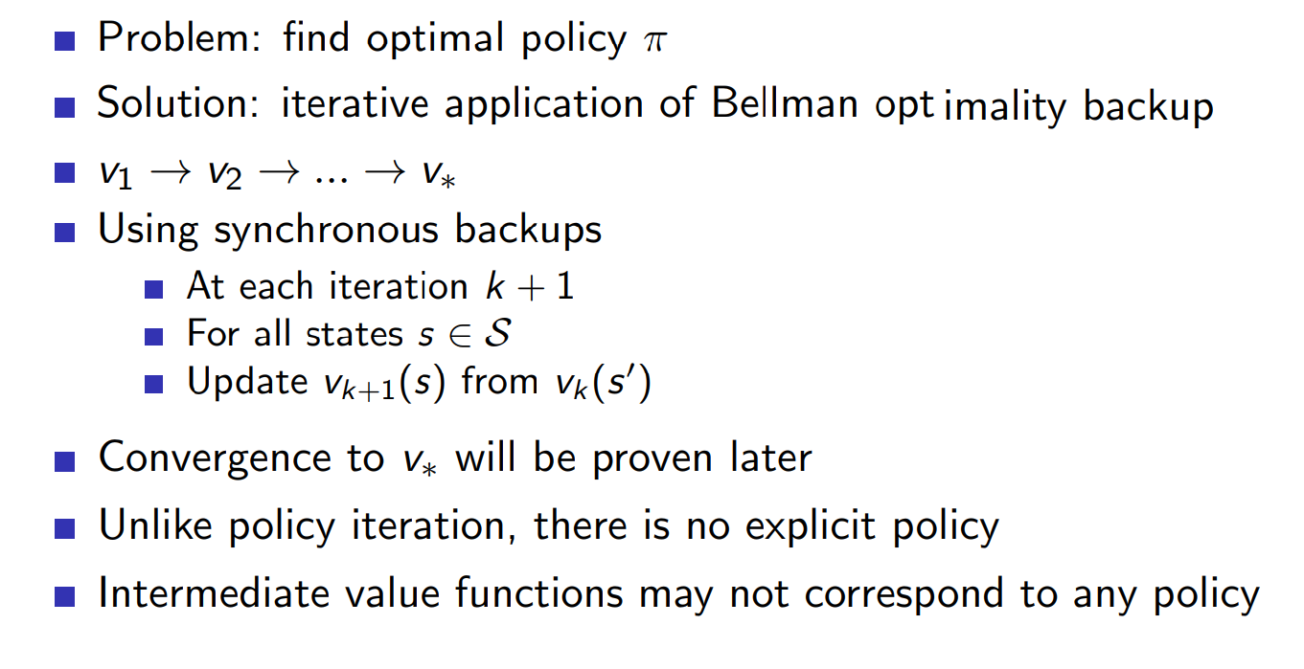
Value Iteration
INTRODUCTION TO COMPUTING
Course Code: CCINCOM/L
Joseph Marvin R. Imperial
REINFORCEMENT LEARNING
NU College of Computing and Information Technologies
Course Code: CCRNFLRL
Notes:
Acting greedily means pick actions in a way that gives us a maximum action value (q).
Action value (q) is the immediate reward plus the value function where you end up.
Follow new greedy policy from one step then follow policy from then onwards starting in s.
Following a greedy policy for one step is better than following the old policy
Then iterate the same process for two, three, four, five steps.

Slide 33

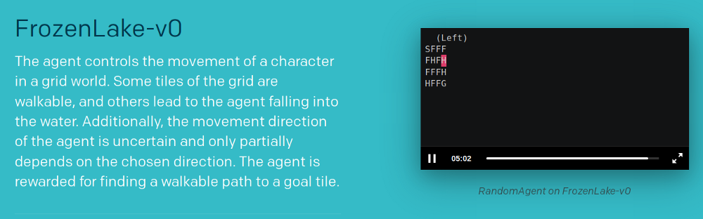
Policy Evaluation & Iteration (Code)
INTRODUCTION TO COMPUTING
Course Code: CCINCOM/L
For the rest of the class time, you will be experimenting with the implementation of policy evaluation and policy iteration in Python using OpenAI Gym.
https://www.gymlibrary.dev/environments/toy_text/frozen_lake/
Joseph Marvin R. Imperial
REINFORCEMENT LEARNING
NU College of Computing and Information Technologies
Course Code: CCRNFLRL

Slide 34
Frozen Lake
INTRODUCTION TO COMPUTING
Course Code: CCINCOM/L
0 | 1 | 2 | 3
4 | 5 | 6 | 7
8 | 9 | 10 | 11
12 | 13 | 14 | 15
S
F
F
F
F
H
F
H
F
F
F
H
H
F
F
G
Joseph Marvin R. Imperial
REINFORCEMENT LEARNING
NU College of Computing and Information Technologies
Course Code: CCRNFLRL

Slide 35
References
INTRODUCTION TO COMPUTING
Course Code: CCINCOM/L
Images are licensed with Creative Commons. Can use without citing.
Prof. Emma Brunskill’s slides (CS234RL). https://web.stanford.edu/class/cs234/slides/lecture1.pdf
David Silver’s slides. https://www.davidsilver.uk/wp-content/uploads/2020/03/intro_RL.pdf
Review in Probability, Intro to RL Concepts
Joseph Marvin R. Imperial
REINFORCEMENT LEARNING
NU College of Computing and Information Technologies
Course Code: CCRNFLRL

